Slide 1
Deadlocks

Slide 2
Deadlocks
Deadlock : A set of processes is deadlocked if each process in the set is waiting for an event that only another process in the set can cause.
Example
System has 2 disk drives.
P₁ and P₂ each hold one disk drive and each needs another one.
Example
semaphores A and B, initialized to 1
P₀ P₁
wait (A); wait(B);
wait (B); wait(A);

Slide 3
Deadlocks…
A process is deadlocked if it is waiting for an event that will never occur.
Typically, more than one process will be involved in a deadlock.
A process is indefinitely postponed if it is delayed repeatedly over a long period of time while the attention of the system is given to other processes,
i.e. the process is ready to proceed but never gets the CPU.

Slide 4
System Model
Resource types
R1, R2,….Rn
Each resource type Ri has Wi instances
Assume reusable resources
request -> use -> release
Request & release are system calls.(open/close file, alloc/free memory location etc). It can be accomplished with wait and signal operations on semaphore.

Slide 5
Deadlock Characterization
Deadlock can arise if four conditions hold simultaneously.
Mutual exclusion: only one process at a time can use a resource.
Hold and wait: a process holding at least one resource is waiting to acquire additional resources held by other processes.
No preemption: a resource can be released only voluntarily by the process holding it, after that process has completed its task.
Circular wait: there exists a set {P₀, P₁, …, P_{n}} of waiting processes such that P₀ is waiting for a resource that is held by P₁, P₁ is waiting for a resource that is held by P2 and so on. …, P_{n–1} is waiting for a resource that is held by P_{n}, and P_{n} is waiting for a resource that is held by P₀. i.e A circular chain of processes exists in which each process waits for one or more resources held by the next process in the chain.

Slide 6
Resource-Allocation Graph
A set of vertices V and a set of edges E.
V is partitioned into two types:
P = {P₁, P₂, …, P_{n}}, the set consisting of all the processes in the system.
R = {R₁, R₂, …, R_{m}}, the multi-set consisting of all resource types in the system.
Request edge – directed edge P_{i} → R_{j}
Assignment edge – directed edge R_{j} → P_{i}

Slide 7


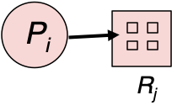
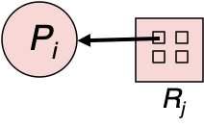
Resource-Allocation Graph…
Process
Resource Type with 4 instances
P_{i} requests an instance of R_{j}
P_{i} is holding an instance of R_{j}

Slide 8
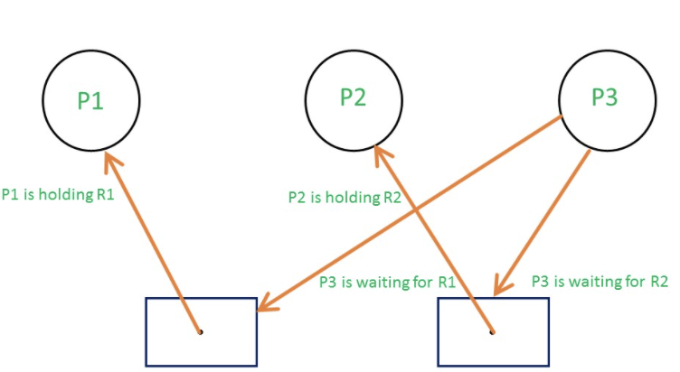
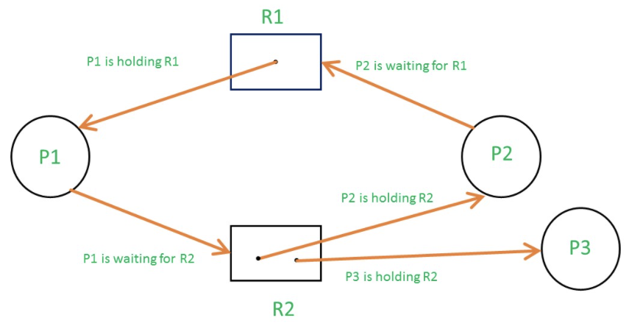
Resource Allocation Graph Example

Slide 9
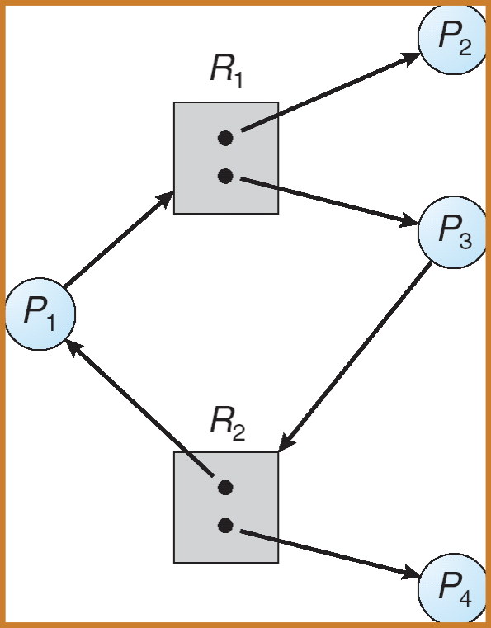
Graph With A Cycle But No Deadlock

Slide 10
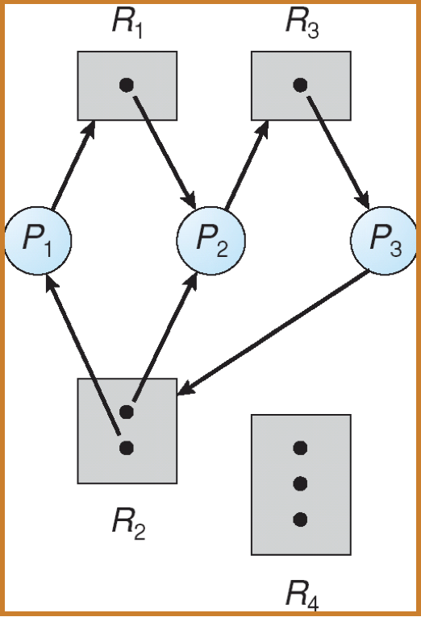
Resource Allocation Graph With A Deadlock

Slide 11
Basic Facts
If graph contains no cycles
no deadlock.
If graph contains a cycle
if only one instance per resource type, then deadlock.
if several instances per resource type, possibility of deadlock.

Slide 12
Methods for handling deadlocks
Ensure that the system will never enter a deadlock state. Use a Protocol for prevent or avoid deadlocks.
Allow the system to potentially enter a deadlock state, detect it and then recover.
Ignore the problem and pretend that deadlocks never occur in the system;
Used by many operating systems, e.g. UNIX

Slide 13
Deadlock Management
Prevention
Design the system in such a way that deadlocks can never occur. (by constraining how requests for resources can be made in the system)
Provides set of methods for ensuring that at least one of the necessary conditions cannot hold.
Avoidance
The system dynamically considers every request and decides whether it is safe to grant it at this point.
The system requires additional appropriate information regarding the overall potential use of each resource for each process.

Slide 14
Deadlock Management…
Detection
Allow possibility of deadlock, determine if deadlock has occurred and which processes and resources are involved.
Recovery
After detection, clear the problem, allow processes to complete and resources to be reused. May involve destroying and restarting processes.

Slide 15
Deadlock Prevention
If any one of the conditions for deadlock (with reusable resources) is denied, deadlock is impossible.
Mutual Exclusion
no-issue for sharable resources
cannot deny this for non-sharable resources.
Hold and Wait - guarantee that when a process requests a resource, it does not hold other resources.
Force each process to acquire all the required resources at once (before execution).
The process will make a new request for resources after releasing the current set of resources.
Low resource utilization.
Starvation is possible.

Slide 16
Deadlock Prevention…
No Preemption
Preempt the resources from process.
Preempted resources are added to the list of resources for which the process is waiting.
Process will be restarted only when it can regain its old resources as well as the new ones that it is requesting.
When a process request for some resources, first check if its available, allocate if so. Otherwise check if its allocated to the waiting process. If so preempt the resources of a waiting process and allocate to the requesting process. If both don’t hold, the requesting process is made to wait.

Slide 17
Deadlock Prevention…
Circular Wait
Impose a total ordering of all resource types.
Require that processes request resources in increasing order of enumeration; if a resource of type N is held, process can only request resources of types > N.
Let R = { R1, R2,.... Rm } be resource types. Assign each resource type a unique natural number, which allows to compare between two resources and to determine whether one proceeds another in ordering. F: R->N.
Initially process can request any number of instances of a resource type.
After that process can request a resource Rj only if F(Rj)> F(Ri).
In this way circular wait is prevented.
i.e F(R0)< F(R1) < F(R2)...<F(Rn) < F(R0) is impossible.

Slide 18
Deadlock Avoidance
Requires that the system has some additional a priori information available.
Simplest and most useful model requires that each process declare the maximum number of resources of each type that it may need.
The deadlock-avoidance algorithm dynamically examines the resource-allocation state to ensure that there can never be a circular-wait condition.
Resource-allocation state is defined by the number of available and allocated resources, and the maximum demands of the processes.

Slide 19
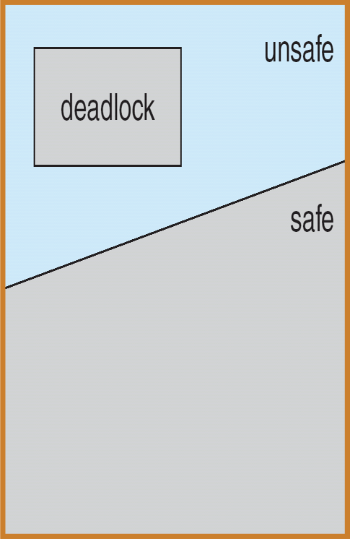
Safe State
System is in safe state if there exists a sequence <P₁, P₂, …, P_{n}> of ALL the processes is the system such that for each P_{j}, the resources that P_{j} can still request can be satisfied by currently available resources + resources held by all the P_{i}, with i< j.
That is:
If P_{j} resource are not immediately available, then P_{j} can wait until all P_{i} have finished.
When P_{i} is finished, P_{j} can obtain needed resources, execute, return allocated resources, and terminate.
When P_{j} terminates, P_{j +1} can obtain its needed resources, and so on.

Slide 20
Safe State…
System is in a safe state ⇒ no deadlocks
If system is deadlocked ⇒ state is unsafe
System is in unsafe state ⇒ possibility of deadlock.
OS cannot prevent processes from requesting resources in a sequence that leads to deadlock
Deadlock Avoidance
Ensures system will never enter an unsafe state.
Thereby avoids the possibility of deadlock.

Slide 21
Deadlock Avoidance - Concepts
Key Ideas:
Initially the system is in a safe state
Whenever a process requests an available resource, system will allocate resource immediately only if the resulting state is still safe!
Otherwise, requesting process must wait.
Why does this work?
By induction, all reachable states are safe states
By definition, all safe states are not deadlocked

Slide 22
Avoidance algorithms
Single instance of a resource type
Use a resource-allocation graph
Multiple instances of a resource type
Use the banker’s algorithm

Slide 23
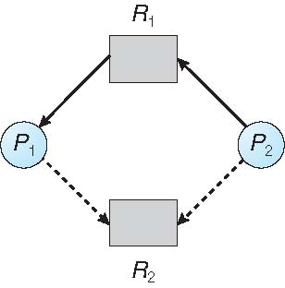
Resource-Allocation Graph
Claim edge: Pi → Rj indicates that process Pi may request resource Rj; represented by a dashed line.
Claim edge converts to request edge when a process requests a resource.
When a resource is released by a process, assignment edge reconverts to claim edge.
Resources must be claimed a priori in the system.
The request can be granted only if converting the request edge to an assignment edge does not result in the formation of a cycle in the resource allocation graph.
If request assignment does not result in the formation of a cycle in the resource allocation graph - safe state, else unsafe state.

Slide 24
Banker’s Algorithm
Used for multiple instances of each resource type.
When a new process enters the system, it must declare the maximum number of instances of each resource type that it may need.
This number should not exceed the number of resources in a system.
When a process requests a resource, the OS checks if the allocation leaves the system in a safe state. If so, the OS allocates the resources, otherwise the process must wait.
When a process gets all its resources, it must return them in a finite amount of time.

Slide 25
Data Structures for the Banker’s Algorithm
Let n = number of processes and m = number of resource types.
Available: Vector of length m. If Available[j] = k, there are k instances of resource type R_{j} available.
Max: n × m matrix. If Max[i,j] = k, then process P_{i} may request at most k instances of resource type R_{j.}
Allocation: n × m matrix. If Allocation[i,j] = k, then process P_{i} is currently allocated k instances of resource type R_{j}.
Need: n × m matrix. If Need[i,j] = k, then process P_{i} may need k more instances of resource type R_{j} to complete its task.
Need[i,j] = Max[i,j] - Allocation[i,j]

Slide 26
Safety Algorithm
Let Work and Finish be vectors of length m(number of resources) and n(number of processes), respectively. Initialize
Work := Available
Finish[i] := false for i = 0,1,2,…,n-1.
Find an i (i.e. process P_{i}) such that both:
(a) Finish[i] = false
(b) Need_{i} <= Work
If no such i exists, go to step 4.
Work := Work + Allocation_{i}
Finish[i] := true
go to step 2
If Finish[i] = true for all i, then the system is in a safe state.

Slide 27
Example
5 processes P₀ through P₄;
3 resource types:
A (10 instances), B (5instances), and C (7 instances)
Snapshot at time T₀:
Allocation Max Available
A B C A B C A B C
P₀ 0 1 0 7 5 3 3 3 2
P₁ 2 0 0 3 2 2
P₂ 3 0 2 9 0 2
P₃ 2 1 1 2 2 2
P₄ 0 0 2 4 3 3

Slide 28
Example...
The content of the matrix Need is defined to be Max – Allocation
Need
A B C
P₀ 7 4 3
P₁ 1 2 2
P₂ 6 0 0
P₃ 0 1 1
P₄ 4 3 1
The system is in a safe state since the sequence < P₁, P₃, P₀, P₂, P₄> satisfies safety criteria

Slide 29
Resource-Request Algorithm for Process P_{i}
Request_{i} = request vector for process P_{i}. If Request_{i}[j] = k, then process P_{i} wants k instances of resource type R_{j}.
If Request_{i} ≤ Need_{i}, go to step 2. Otherwise, raise error condition, since process has exceeded its maximum claim.
If Request_{i} ≤ Available, go to step 3. Otherwise, P_{i} must wait since resources are not available.
Pretend to allocate requested resources to P_{i} by modifying the state as follows:
Available := Available - Request_{i};
Allocation_{i}:= Allocation_{i}+ Request_{i};
Need_{i} := Need_{i} - Request_{i};
If safe ⇒ resources are allocated to P_{i}.
If unsafe ⇒ P_{i} must wait and the old resource-allocation state is restored.

Slide 30
Example: P₁ Request (1,0,2)
Check that Request ≤ Available (that is, (1,0,2) ≤ (3,3,2) ⇒ true
Allocation Need Available
A B C A B C A B C
P_{0.} 0 1 0 7 4 3 2 3 0
P₁ 3 0 2 0 2 0
P₂ 3 0 2 6 0 0
P₃ 2 1 1 0 1 1
P₄ 0 0 2 4 3 1
Executing safety algorithm shows that sequence < P₁, P₃, P₀, P₂, P₄> satisfies safety requirement
Can request for (3,3,0) by P₄ be granted?
Can request for (0,2,0) by P₀ be granted?

Slide 31
Deadlock Detection
Allow system to enter deadlock state
Provide an Algorithm that examines the state of the system to determine whether a deadlock has occurred (deadlock detection)
Note: Detection scheme requires overhead that includes the runtime costs of maintaining the necessary information and executing the detection algorithm.

Slide 32
Single Instance of Each Resource Type
Maintain wait-for graph
Remove the resource nodes from RA graph. So now nodes are only processes
Remove the corresponding edges. i.e Instead of P_{i}->R_{q} & R_{q}->P_{j} for some resource R_{q}, use P_{i} → P_{j} if Pi is waiting for P_{j}.
Periodically invoke an algorithm that searches for a cycle in the graph.
An algorithm to detect a cycle in a graph requires an order of n² operations, where n is the number of vertices in the graph.

Slide 33
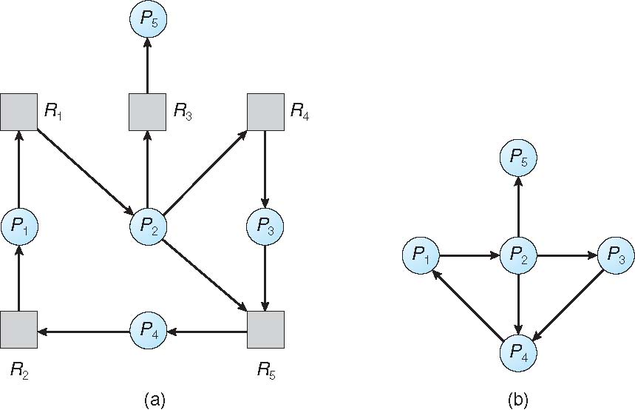
Example
Resource-Allocation Graph
Corresponding wait-for graph

Slide 34
Several Instances of a Resource Type
Data Structures
Available: Vector of length m. If Available[j] = k, there are k instances of resource type R_{j} available.
Allocation: n × m matrix. If Allocation[i,j] = k, then process P_{i} is currently allocated k instances of resource type R_{j}.
Request : An n × m matrix indicates the current request of each process. If Request [i,j] = k, then process P_{i} is requesting k more instances of resource type R_{j} .

Slide 35
Deadlock Detection Algorithm
Step 1: Let Work and Finish be vectors of length m and n, respectively. Initialize:
(a) Work = Available
(b) For i = 1,2, …, n, if Allocation_{i} ≠ 0, then Finish[i] = false; otherwise, Finish[i] = true
Step 2: Find an index i such that both:
Finish[i] == false
Request_{i} ≤ Work
If no such i exists, go to Step 4.
Step 3: Work := Work + Allocation_{i}
Finish[i] := true
go to Step 2
Step 4: If Finish[i] = false for some i, 1 ≤ i ≤ n, then the system is in a deadlock state. Moreover, if Finish[i] = false, then P_{i} is deadlocked.
O(m x n² )

Slide 36
Example of Detection Algorithm
Five processes P₀ through P₄; three resource types A (7 instances), B (2 instances), and C (6 instances)
Snapshot at time T₀:
Allocation Request Available
A B C A B C A B C
P₀ 0 1 0 0 0 0 0 0 0
P₁ 2 0 0 2 0 2
P₂ 3 0 3 0 0 0
P₃ 2 1 1 1 0 0
P₄ 0 0 2 0 0 2
Sequence <P₀, P₂, P₃, P₁, P₄> will result in Finish[i] = true for all i

Slide 37
Example of Detection Algorithm…
P₂ requests an additional instance of type C
Request
A B C
P₀ 0 0 0
P₁ 2 0 2
P₂ 0 0 1
P₃ 1 0 0
P₄ 0 0 2
State of system?
Can reclaim resources held by process P₀, but insufficient resources to fulfill other processes; requests
Deadlock exists, consisting of processes P₁, P₂, P₃, and P₄

Slide 38
Detection-Algorithm Usage
When, and how often to invoke depends on:
How often a deadlock is likely to occur?
How many processes will need to be rolled back?
How often?
Every time a request for allocation cannot be granted immediately
Allows os to detect set of deadlocked processes and process that “caused” deadlock. Extra overhead.
Every hour or whenever CPU utilization drops. With arbitrary invocation there may be many cycles in the resource graph and we would not be able to tell which of the many deadlocked processes “caused” the deadlock.

Slide 39
Recovery from Deadlock
When the detection algorithm detects that deadlock exists either user can deal with it manually or OS automatically recover from deadlock.
Two options to break deadlock automatically
Abort one or more processes
Preempt some resources from one or more deadlocked processes.

Slide 40
Process Termination
Abort all deadlocked processes
Very expensive as processes may have computed for a long time & this must be discarded and recompute it later.
Abort one process at a time until the deadlock cycle eliminated
Adds up overhead, since after each process is aborted, a deadlock-detection algorithm must be invoked to determine whether any processes are still deadlocked.
Issues with aborting the processes
If the process is in mid of printing/updating file then OS must reset the values before proceeding with next request.
Factors to be considered while terminating the processes
Priority of the processes
How many and what types of resources are used/ required to complete?
Foreground process/ Background process?
How long the process has executed and how much longer is required to complete the task.

Slide 41
Resource Preemption
To eliminate deadlocks, preempt some of resources and give these resources to other processes until the deadlock cycle is broken.
3 Issues need to be addressed
Selecting a victim: Which resources and which processes are to be preempted?
Sol^{n}: Select the one to minimize the cost. Parameters can be number of resources held, How long the process has computed etc.
Rollback: What should be done with the process for which resources are preempted?
Sol^{n}: Either rollback the process from safe state (overhead added to OS) or total rollback (abort the process and then restart it)
Starvation: How can we guarantee that resources will not always be preempted from the same process?
Sol^{n}: Include the number of rollbacks in the cost factor while selecting the victim.

